Slide 1
Second grade Unit 6
Healthy habits…
  Can you write a poem about a food that you really dislike?

Slide 2

I’m breaking up with broccoli
I’m breaking up with broccoli.
I’ve said it and it’s true.
I’m breaking up with broccoli,
There’s nothing you can do.

Slide 3


They say it looks like little trees,
They say it’s good for bones and knees…

Slide 4

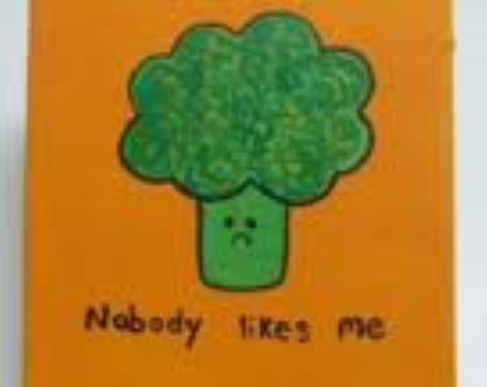
Just give me chocolate if you please.
I’m breaking up with broccoli.

Slide 5
Now write your poem!!
I’m breaking up with….

